Slide 1

Bachelor of Engineering Sem -VII
PROJECT PRESENTATION
Computer Engineering Department VIVA Institute Of Technology, Virar (East)
University of Mumbai
Academic Year 2022-23

Slide 2
A PRESENTATION ON
“WAVD : WEB APPLICATION VULNERABILITY DETECTOR”
By
ROHAN SHARMA(34)
SHUBHAM YADAV(35)
DHIRAJ MISHRA(36)
Under the guidance of
Prof. Akshaya Prabhu

Slide 3
INTRODUCTION
Web applications have become an integral part of everyday life, but many of these applications are associated with vulnerabilities.
In this era, where website hosting has become cheap and easy, the security has failed to keep up.
Such vulnerabilities can risk small scale to large scale industries.
A large number of applications are becoming online, but how secure these applications are a matter of concern. Thus, it becomes necessary to find vulnerabilities that may cause severe risk to user’s security.
So, we are developing a system that will find these vulnerabilities in given web applications and report them to the user of the system

Slide 4
LITERATURE SURVEY
TITLE | SUMMARY | ADVANTAGE | TECHNOLOGY USED
Web Vulnerability Scanner. | The project comes underneath linguistics uniform resource locator. System tend to studied numerous vulnerabilities like Remote File Inclusion, Locate File Inclusion, SQLI, Cross-Site Scripting. | Here, System mainly concentrates on detection and prevention of web application by using various techniques such as Dynamic Allocation, File Size Verification, Digital Signature and Sanitization of Input. | Javascript, Python
Web Application Security Scanner for Prevention and Protection against Vulnerabilities | Vulnerabilities like SQL injection,cross site scripting,broken authentication,payload,email disclosure.If a situation arrives where the scanner cannot detect the vulnerability, then the attacker can easily crawl into the system and exploit the data and resources, so various scanner are compared | The above proposed scanner is best suited for beginners who are not aware of the complex steps of scanning Vulnerability scanning identifies the security vulnerabilities in an organization.. | Burp Suite, fuzzy testing, Javascript, Python
Research on Web Application Security Vulnerability Scanning Technology. | Such as XSS Detection, SQL Injection Detection and File upload Vulnerability A web application vulnerability detection method is proposed, combining the fuzzy test method to enable the scanning system to automatically detect vulnerabilities. | The system provided XSS and SQL Injection Detection and the File Upload Vulnerability.The main advantage is detecting the malicious file and verifying before getting uploaded to server. | Fuzzy testing,Javascript, Python

Slide 5
LITERATURE SURVEY
TITLE | SUMMARY | ADVANTAGE | TECHNOLOGY USED
Phishing Detection Using Machine Learning Techniques | In this paper, a comparative evaluation of different machine learning methods provided on detecting the phishing websites. They used different methods of feature selection for getting the best results. | The main advantage of XGBoost is its fast speed compared to other algorithms, such as ANN and SVM, and it's regularization parameter that successfully reduces variance | Logistic regression, Ada booster, random forest. KNN, neural networks, SVM, Gradient boosting, XGBoost
Phishing Website Detection Using Machine Learning Algorithms | This paper deals with machine learning technology for detection of phishing URLs by extracting and analyzing various features of legitimate and phishing URLs. Decision Tree, random forest and Support vector machine algorithms are used to detect phishing websites. | The Random forest classifier gives best accuracy with lowest false negative rate than other two classifiers. | Decision Tree, Random forest and Support Vector Machine
Automated Web Application Vulnerability Scanner. | The system will scan the target application and check if the web application is having any of these vulnerabilities: SQL Injection and Cross Site Scripting The report will be generated consisting of endpoint affected, payload used, and generalized remediation. | Supports automated and reliable crawling. Optimized use of the numbon.er of threads to control the load on the target application. | Javascript, Python

Slide 6
RESEARCH GAP & SCOPE
Research Gap :-
There are tools that detects vulnerabilities but they are not open source and also expensive.Most of the scanners detects few vulnerabilities generally the most common SQL Injection and XSS injection.One of the most common attack that is phishing is not detected in most Vulnerability systems.
Scope :-
We are going to scan rare vulnerabilities which affects the whole system. We have added phishing detection using machine learning with best accuracy
94.32% using XGradient Boost. Certificate Validation vulnerabilities will be added in the system.

Slide 7
PROBLEM STATEMENT & OBJECTIVE
There is unavailability of automated scanners for detecting vulnerabilities in web applications. And some scanners which are present are highly expensive. This leads to defacement, hijacking, stealing data from the server. This creates a security problem for all businesses as well as government people. So, making an affordable scanner is important. Scanners first crawl the web pages of a particular domain and scan each URL using different payloads and find out if a URL is vulnerable or not.
The aim here is to develop WAVD (Web App Vulnerability Detector), a tool to scan & test URLs for certain vulnerabilities & security issues by simply inspecting the corresponding client-side website.
• Absence of Valid TLS Certificates
• Cross-Site Scripting (XSS)
• Potential Phishing Attempts
• Open Redirection

Slide 8
ALGORITHM
Step 1: Start
Step 2: Configure Browser
Step 3: Start Web Browser
Step 4 : Start Intercept Proxy
Step 5 : Enter URL
Step 6 : Send URL to restful API component
Step 7 : Restful API will call services
Step 8 : Servers will perform security checks
Step 9 : Restful API fetches security check results
Step 10 : Proxy will fetch results
Step 11 : Results will be formatted in HTML
Step 12 : It will return the result on the web browser
Step 13 : Show results
Step 14 : END

Slide 9
DETAILS OF THE SYSTEM
SOFTWARE REQUIREMENTS :
Proxy Server : NodeJs
Virtual Server : Python & FastAPI
WAVD Dashboard : HTML, CSS, JS & Bootstrap Framework
Browser : Google Chrome
IDE : Visual Studio Code
Operating System : Windows & Linux
Jupyter notebook
HARDWARE REQUIREMENTS :
Processor : Intel i3
RAM : 4GB
Storage : 20GB

Slide 10
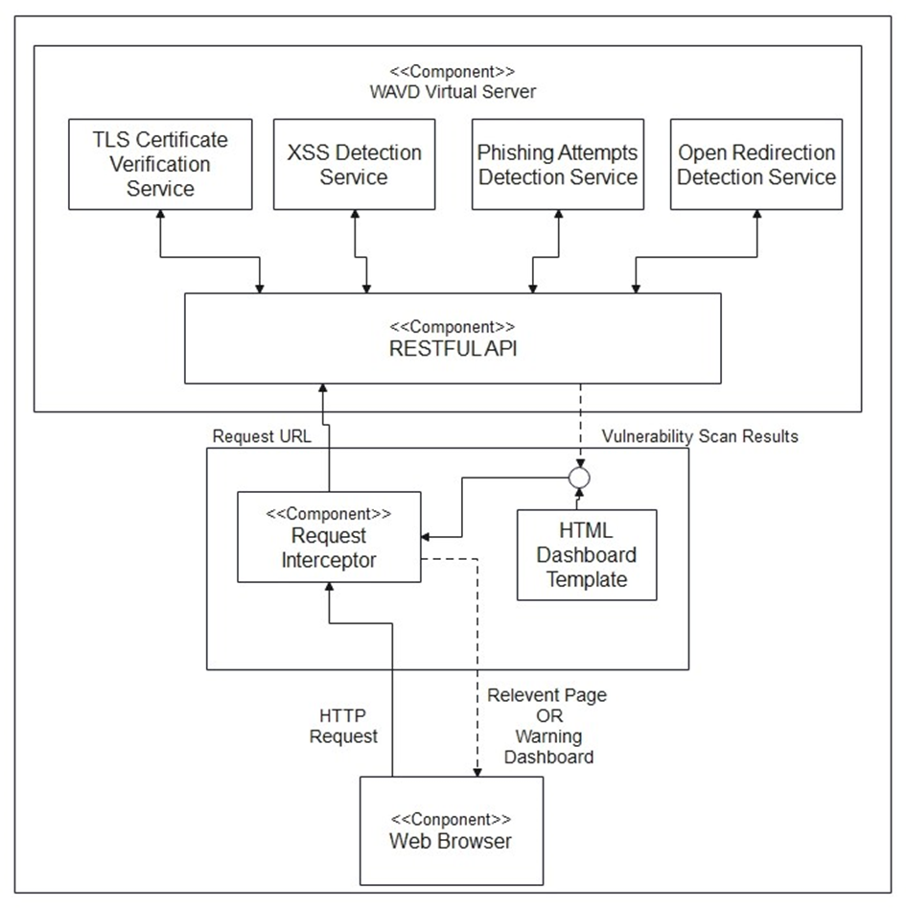
SYSTEM ARCHITECTURE

Slide 11
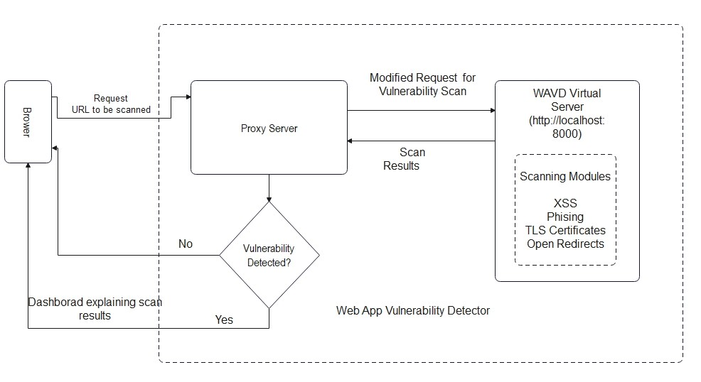
BLOCK DIAGRAM

Slide 12
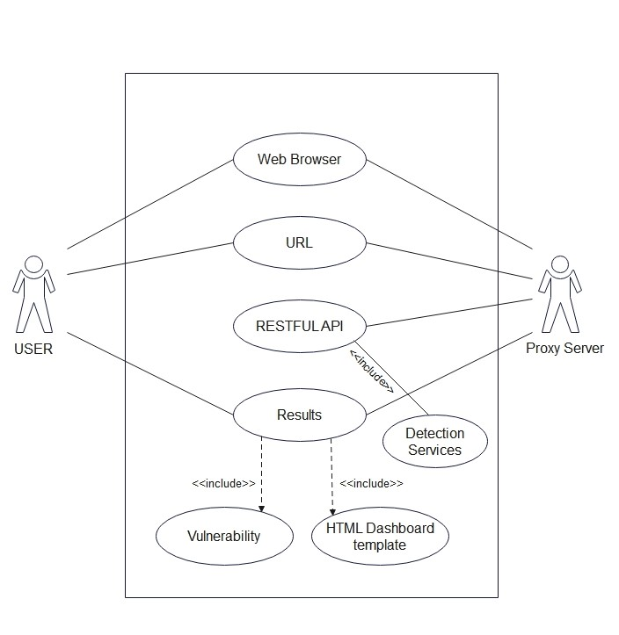
USE CASE DIAGRAM

Slide 13
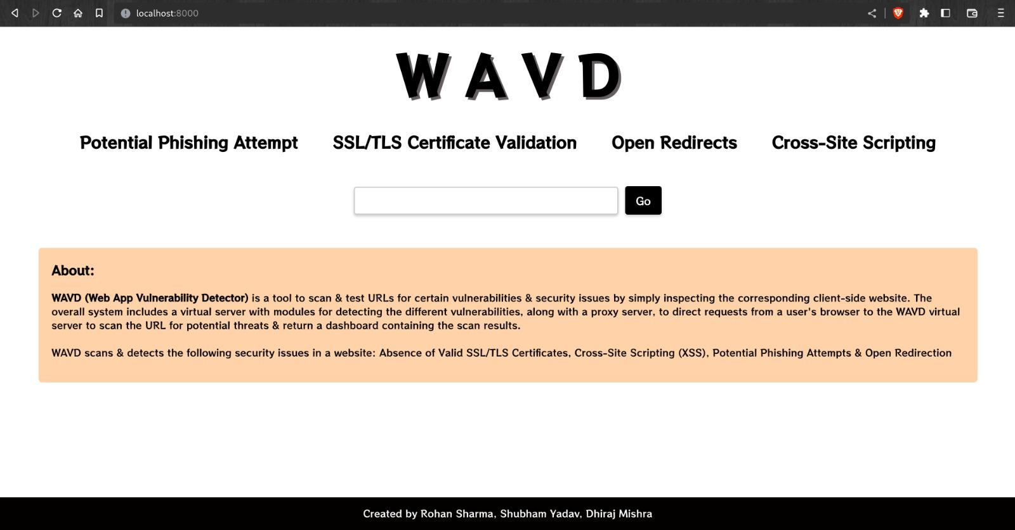
Dashboard

Slide 14
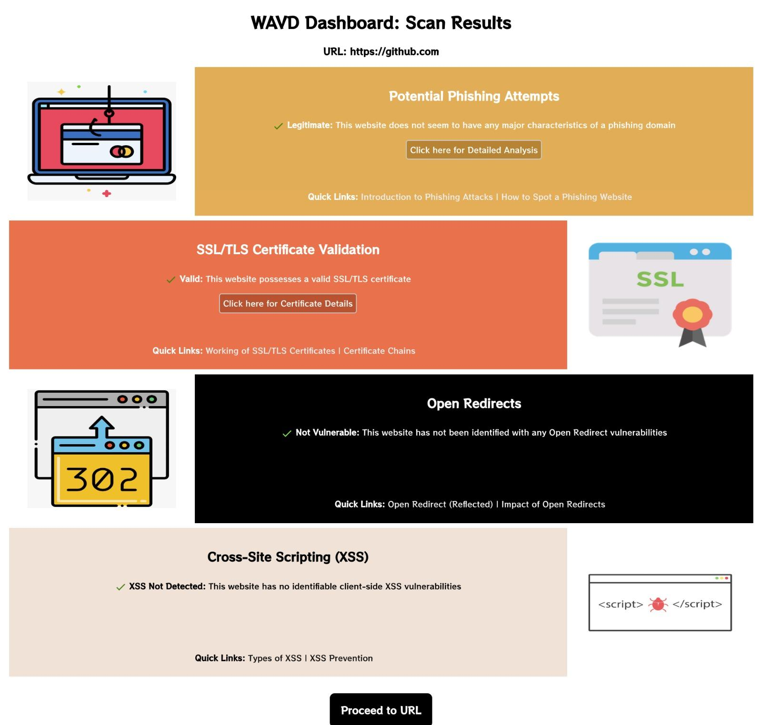

Slide 15
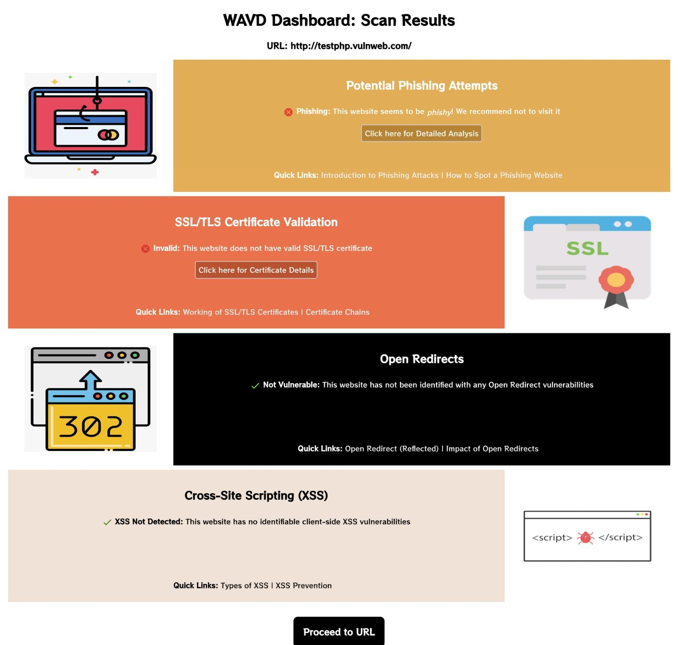

Slide 16
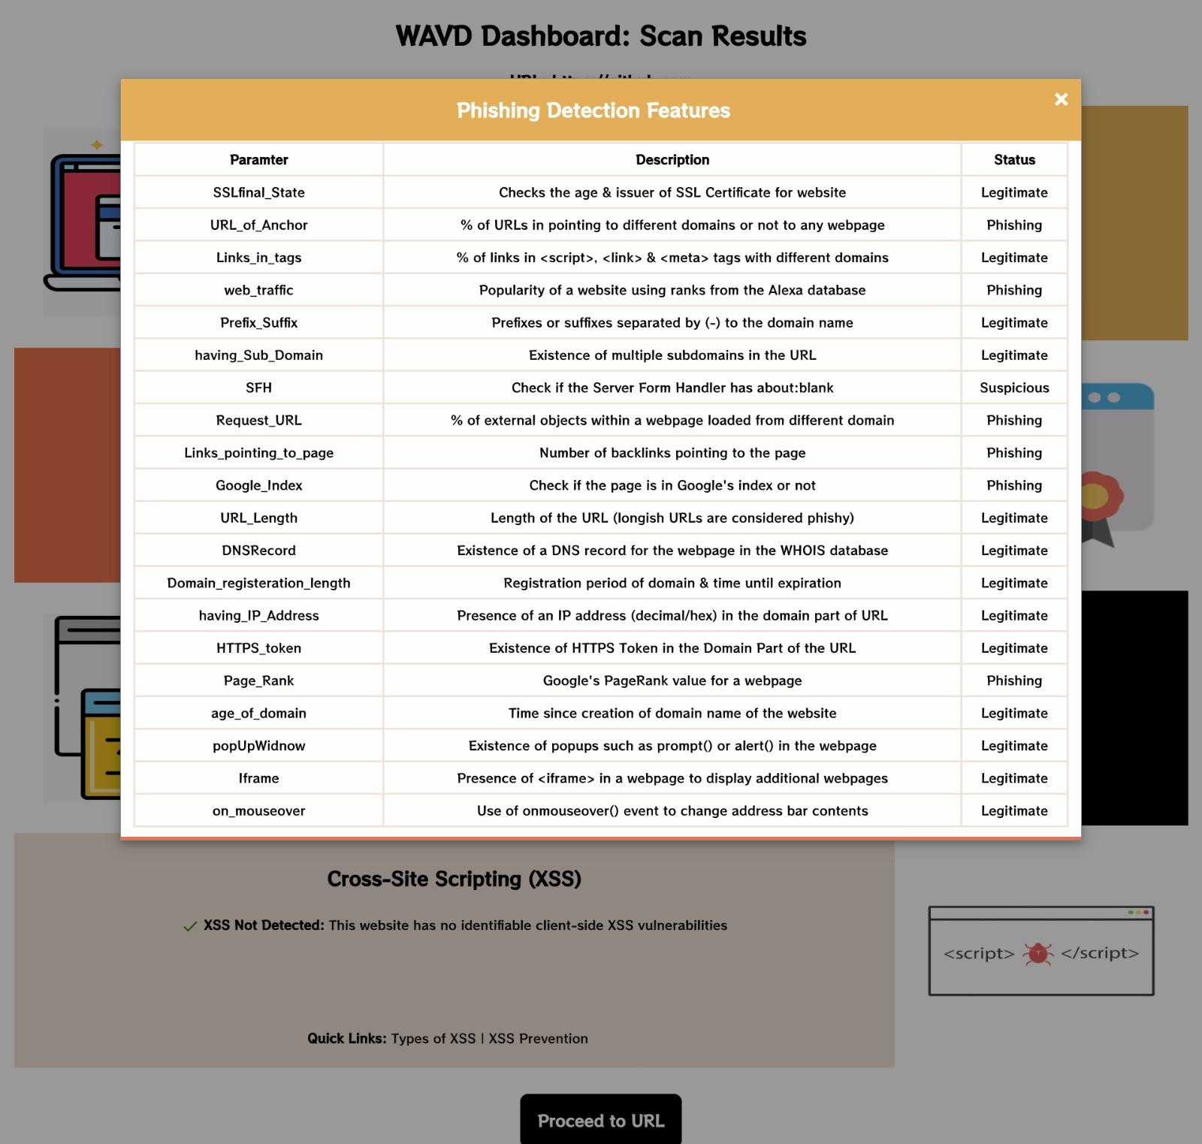

Slide 17
CONCLUSION
The system crawls the entire web application, scan different types of vulnerabilities, and generate a report specifying an overview of the detected vulnerabilities .The system will provide vulnerabilities of the requested URL where the user will get the results through proxy server which will be provided by virtual server where the vulnerabilities are scanned and detected.

Slide 18
THANK YOU

